Slide 1
Angular 9 - Migration

Slide 2
What is Angular 9?
Angular 9 is the latest version of Angular — a platform and framework for building single-page client applications using HTML and TypeScript.
The main building blocks for Angular are modules, components, templates, metadata, data binding, directives, services, and dependency injection.
The component-based structure of Angular makes the components highly reusable across the app.
Being independent of each other, the components make unit testing much easier.

Slide 3
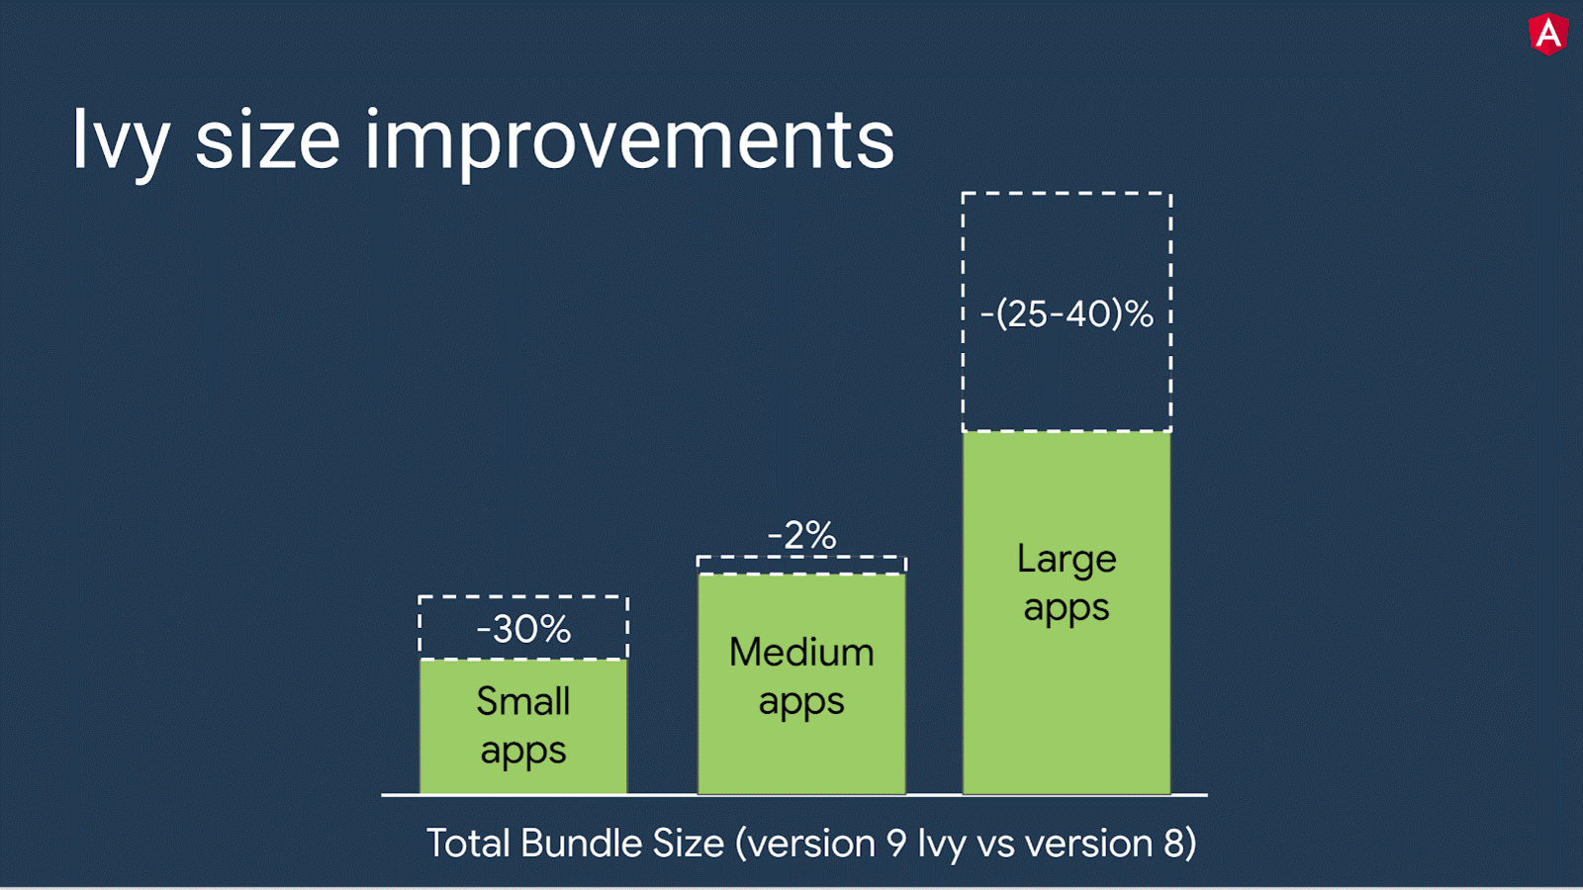
Angular 9 Features
Smaller bundle sizes and enhanced performance.
Improved build times, enabling AOT on by default.
The Ivy compiler: The default use of the Ivy compiler is the most important feature of Angular 9, Ivy is what actually designed to solve the major problems of Angular i.e. the performance and large file size
Improved Internationalization
Latest TypeScript versions

Slide 4
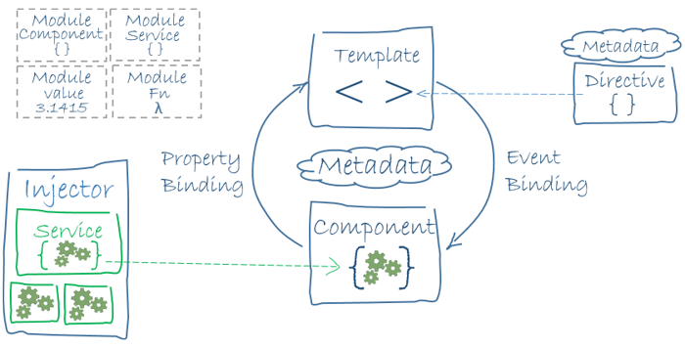
Architecture

Slide 5
Technologies
Node.js - latest version
Angular CLI
Typescript
Html5
CSS3 / SCSS

Slide 6
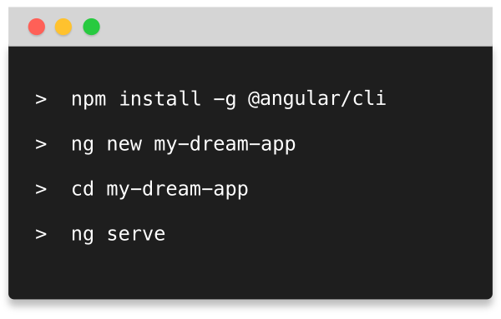
Steps to create new angular project
Install node.js
npm install -g @angular/cli
ng new my-dream-app

Slide 7
Migrate to angular 9
ng update @angular/core @angular/cli
If you are using Angular material You have to update it as well using ng update command.
ng update @angular/material
Also upgrade the 3rd party packages to the version compatible with angular version

Slide 8
Challenges & Next Steps
Challenges
While migrating from one angular version to another, 3rd Party libraries needs to be upgraded as well finding the compatible version of the same becomes difficult sometimes.
Next Steps
Implement interceptors: The Angular HTTP Interceptor is introduced along with the new HTTPClientModule. The Interceptor helps us to modify the HTTP Request by intercepting it before the Request is sent to the back end. The Interceptor can be useful for adding custom headers to the outgoing request, logging the incoming response, etc.

Slide 9
Considerations and Assumptions
Integration
Logging and Error handling: With catchError from Rxjs and HttpInterceptors we can easily write a function to handle errors within each service.
Session Management: State Management, Local Storage and Session Storage can be used for storing session.
Re-usability: Component with similar functionality can be reused across other components.
Scalability: With featured module, lazy loading and state management scalability can be achieved easily

Slide 10
Constraints
One of the major drawbacks to using Angular is the platform’s limited SEO options and poor accessibility for search engine crawlers.
Angular can be quite difficult to learn. With such a complex web of modules, coding languages, integrations and customizing capabilities, understanding it definitely takes some time.

Slide 11
Reference Documentation Links
https://angular.io/
https://nodejs.org/
https://sass-lang.com/
https://www.typescriptlang.org/docs/handbook/typescript-in-5-minutes.html

